Slide 1
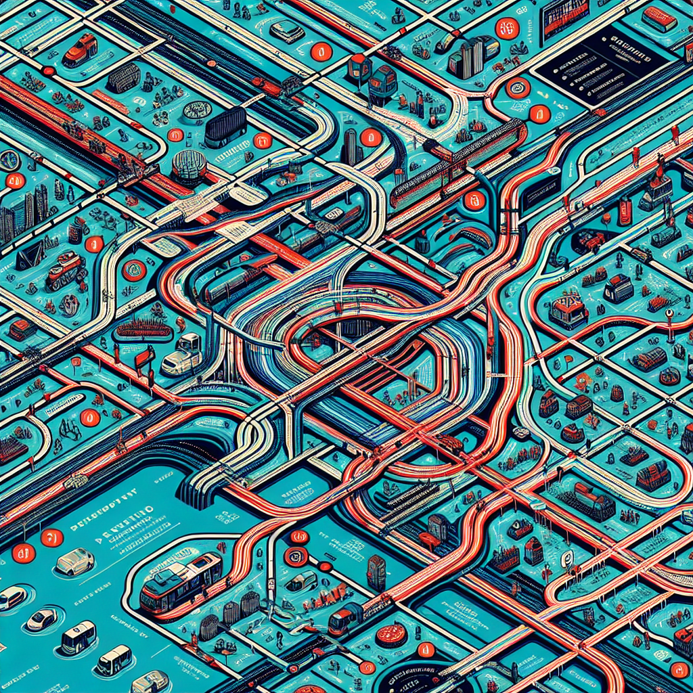
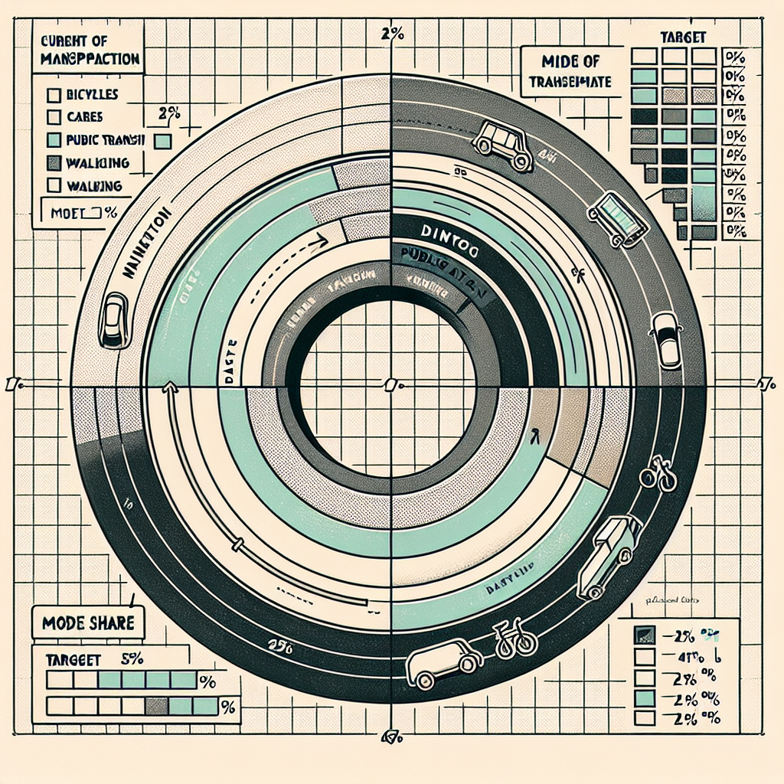
Mobility Modes & Networks
Walking: universal baseline; continuous shade and crossings
Cycling/e‑bikes: protected network; secure parking at shops/schools
Transit: frequent local buses/trams; timed transfers; integrated fares
Micromobility: shared scooters/bikes with designated corrals
Deliveries: cargo bikes and off‑peak loading to reduce conflicts
Car share: right‑sized auto access without ownership
Layered Network Map: - Primary cycling grid (≥ 400 m spacing) in bold color - Secondary cycling links (local streets/greenways) - Transit corridors and stops with frequency symbols - Pedestrian priority streets and school zones Symbology: Line weight by facility class; dots sized by stop frequency Accessibility Overlay: 15‑min walk/bike service areas per mode
Mode Share Donut + Target: Current: Walk 14%, Bike 5%, Transit 18%, Car 63% Target 2030: Walk 20%, Bike 12%, Transit 25%, Car 43% Annotation: Shift enabled by complete networks and pricing reform

